Slide 1
Tiny is the next BIG Thing
daniel.fitzpatrick@americantinyhouseassociation.org

Slide 2
Tiny Home Movement:
Back to the Future
Average # of people
per household has
been dropping for
50 years – now at 2.6
Today….
households are more
diverse …thus a mix
of housing is needed to meet changing demographics

Slide 3
Tiny Homes on Wheels
as 2nd dwelling units
What are they and how are they different
from other housing products?
daniel.fitzpatrick@americantinyhouseassociation.org

Slide 4
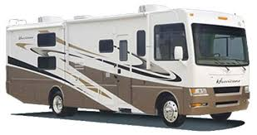
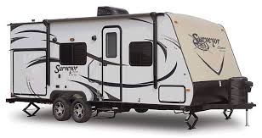
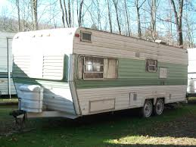
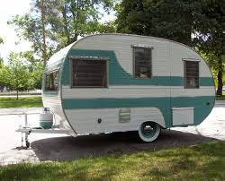
Tiny Homes on Wheels are NOT
your conventional travel trailer or motor home
daniel.fitzpatrick@americantinyhouseassociation.org

Slide 5
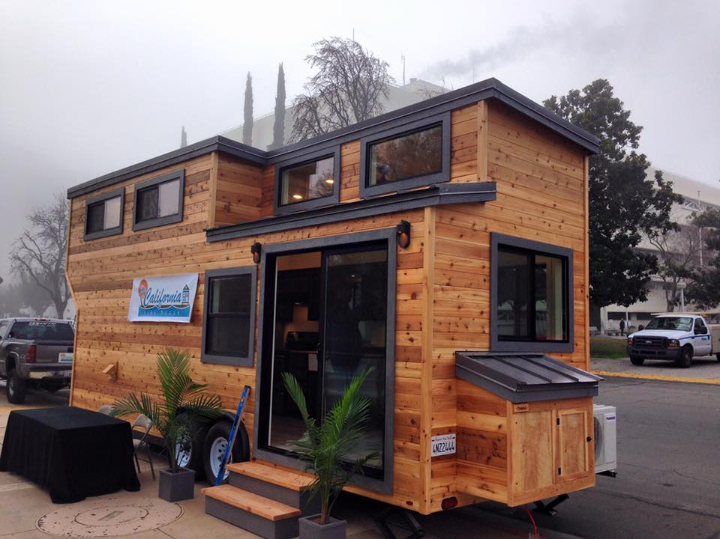
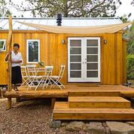
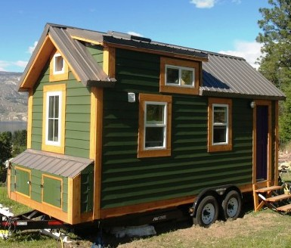
Tiny Homes on Wheels are built to
resemble a typical cottage or bungalow
daniel.fitzpatrick@americantinyhouseassociation.org

Slide 6
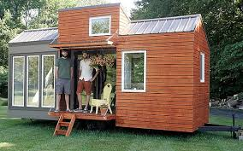
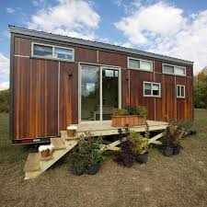
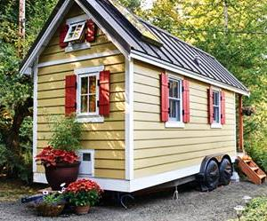
Designs that aesthetically
fit the community
Options that can
complement any setting
daniel.fitzpatrick@americantinyhouseassociation.org

Slide 7
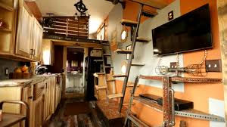
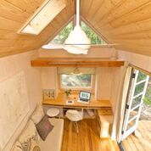
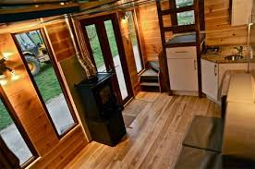
Multiple use
interior design
daniel.fitzpatrick@americantinyhouseassociation.org

Slide 8
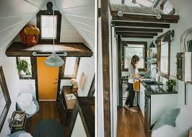
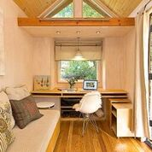
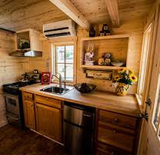
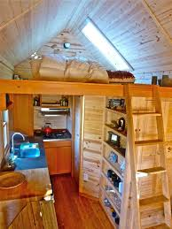
Interiors for independent daily living
Compact
-living
-sleeping
-cooking
-sanitation
-work & recreation
daniel.fitzpatrick@americantinyhouseassociation.org

Slide 9
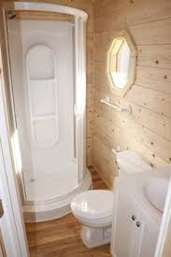
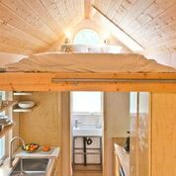
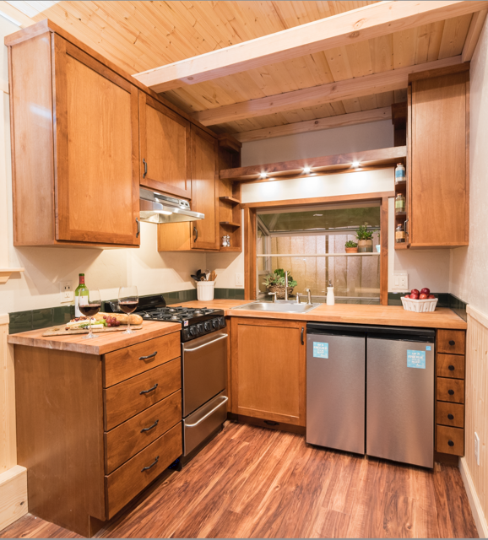
Bathroom
Sleeping Loft
Building options
are unlimited
Kitchens
daniel.fitzpatrick@americantinyhouseassociation.org

Slide 10
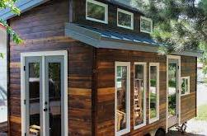
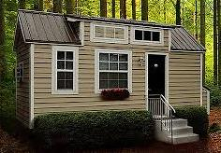
Benefits of Tiny Homes on Wheels
to Community and User
Affordable
Energy efficient – Reduced carbon footprint
Low water/sewer consumption
Sustainable
daniel.fitzpatrick@americantinyhouseassociation.org

Slide 11
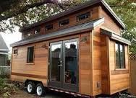
Tiny Home on Wheels benefits: continued
Easy to locate, hookup and maintain
Infill – Increased Density without sprawl
Better use of Community resources/services
Local design and build
daniel.fitzpatrick@americantinyhouseassociation.org

Slide 12
Affordability Analysis
(Investor)
Average THOW cost = $65-$70,000.
Lot prep cost = $25,000 (sewer hookup + trenching,
water and electrical hookup, parking space, fees) =
Total Investment: $90,000 - $95,000
Rent: $750/month or $9,000/year
ROI (Return on Investment): 9.5% ($9,000/$95,000 = 9.5%)
daniel.fitzpatrick@americantinyhouseassociation.org

Slide 13
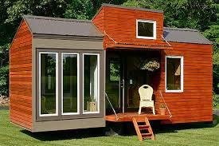
Affordability Analysis
(User & Taxpayer)
Median family income -- $89,000
- Low income (50%) = $ 44,500 x 30% = $13,500
- Very low income (35%) = $31,150 x 30% = $9,345
Thus, a significant portion
of community households can
afford a tiny home on wheels
as a 2nd dwelling unit.
Cost of Affordable housing unit to taxpayer -- $0.00
daniel.fitzpatrick@americantinyhouseassociation.org

Slide 14
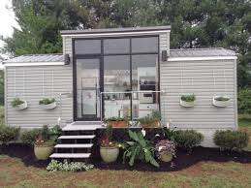
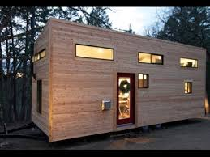
Flexibility of Use
Live/work office
In-Law Suite
Guest House
Caregiver Unit
Student Housing
Studio
Affordable Rental
daniel.fitzpatrick@americantinyhouseassociation.org

Slide 15
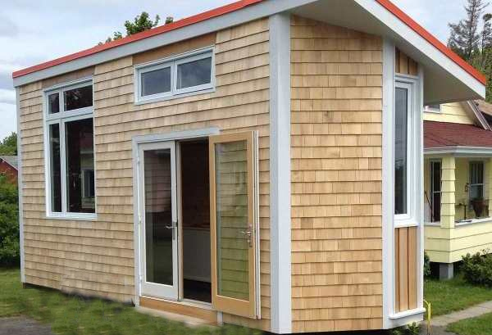
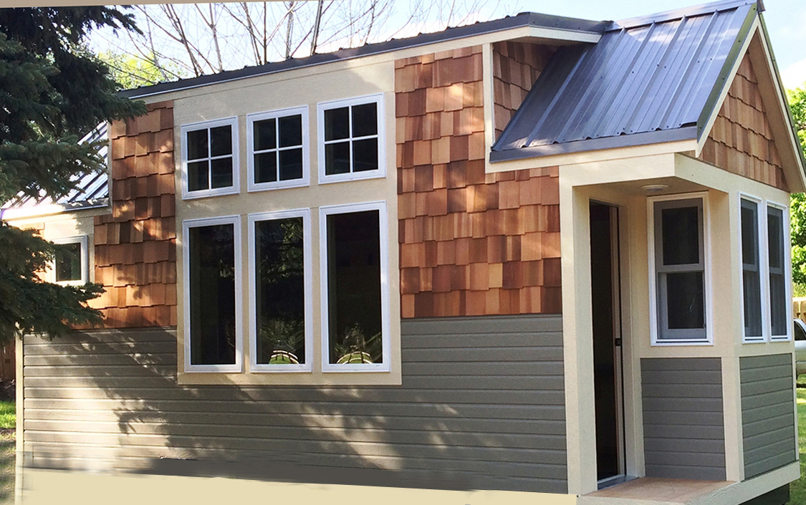
Under current Municipal Code, the cottages
below may well be consider 2nd dwelling units
daniel.fitzpatrick@americantinyhouseassociation.org

Slide 16
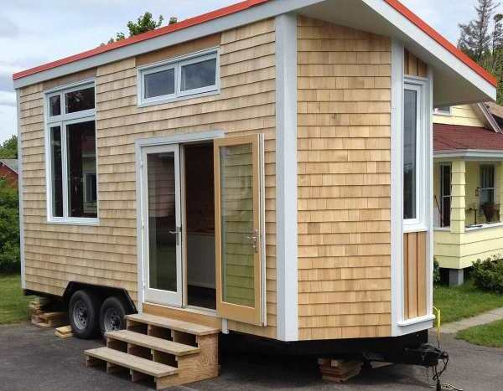
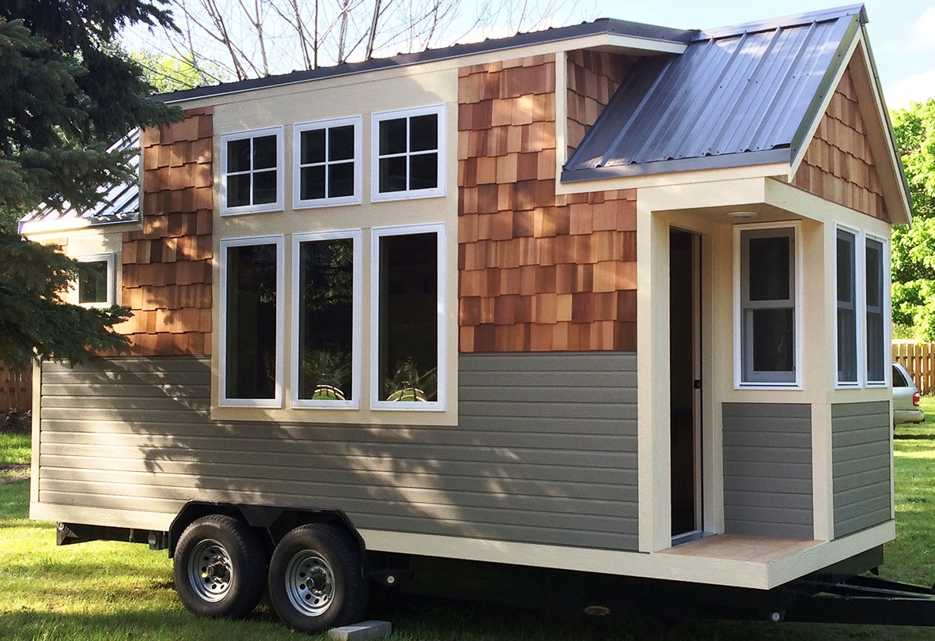
But these cottages would NOT be permitted!
daniel.fitzpatrick@americantinyhouseassociation.org

Slide 17
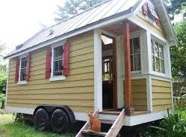
Code amendments required to permit
Tiny Homes on Wheels as
2nd dwelling units
Define tiny
homes on wheels
Establish design criteria
Establish building code standards
daniel.fitzpatrick@americantinyhouseassociation.org

Slide 18
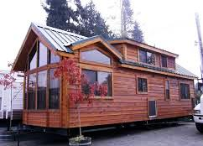
Definition
“Tiny Home on Wheels”. A structure intended for separate, independent living quarters for one household that meets these seven (7) conditions:
Is licensed and registered with the State Department of Motor Vehicles and meets ANSI 119.2 or 119.5 (NFPA 1192) requirements;
Is towable by a bumper hitch, frame-towing hitch, or fifth-wheel connection. Cannot (and is designed not to) move under its own power.
Is no larger than allowed by State Law for movement on public highways;
daniel.fitzpatrick@americantinyhouseassociation.org

Slide 19
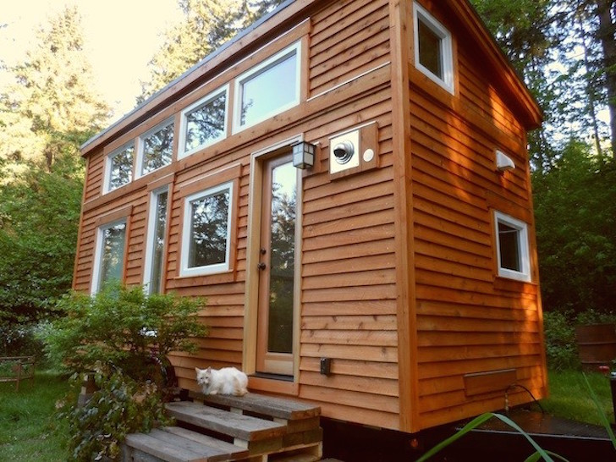
Definition
continued:
4. When sited on a parcel per requirements of this Code, the wheels and undercarriage shall be skirted;
5. Has at least 140 square feet of first floor interior living space;
6. Is a detached self-contained unit which shall include
permanent provisions for living, sleeping, eating, cooking, and sanitation; and
7. Is designed and built to look like a conventional building structure
by meeting design criteria of this ordinance.
daniel.fitzpatrick@americantinyhouseassociation.org

Slide 20
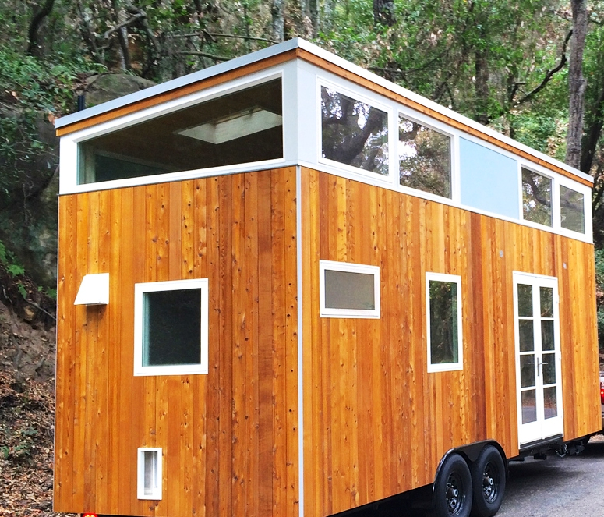
ANSI: American National Standards Institute
https://www.ansi.org/
ANSI provides comprehensive
building standards for Tiny
Homes on Wheels, just as the
Uniform Building Code
provides standards for stick built dwellings
-- Nationally recognized
-- The standard of the State of California
daniel.fitzpatrick@americantinyhouseassociation.org

Slide 21
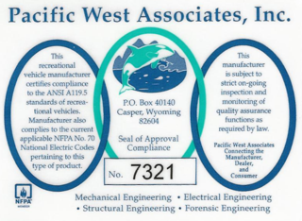
Builders of Tiny Homes on Wheels are becoming
“Certified” through:
--Pacific West Associates, Inc or
--RVIA – Recreational Vehicle Industry Association
These organizations provide added oversight of builders
conformance with ANSI Standards
daniel.fitzpatrick@americantinyhouseassociation.org

Slide 22
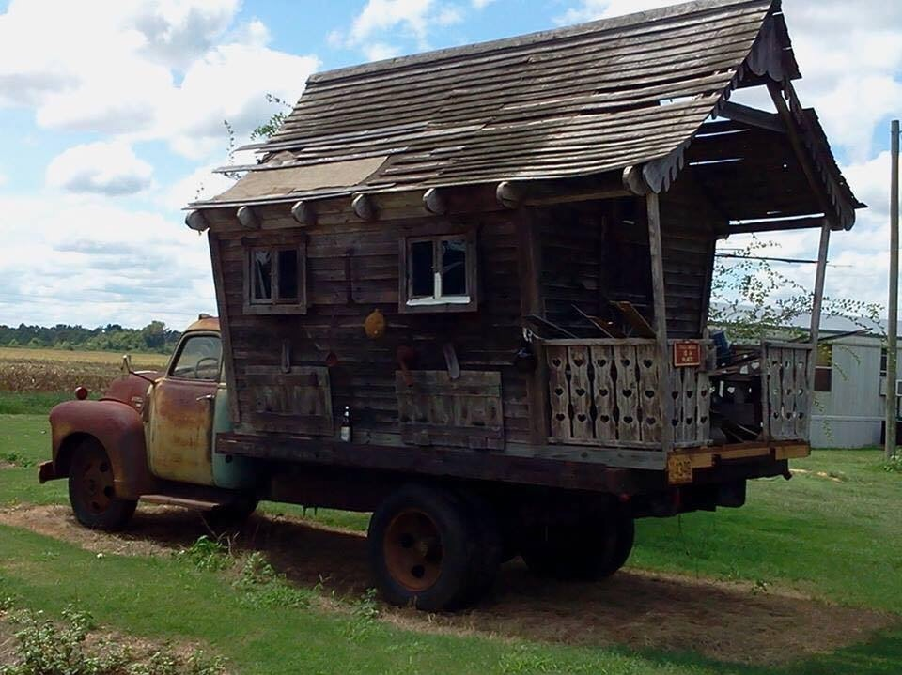
It is important that tiny homes on wheels
meet ANSI and design standards!!
daniel.fitzpatrick@americantinyhouseassociation.org

Slide 23
Design Criteria in Existing Municipal Code
The second unit shall mirror or complement the
primary residence in form, height, number of stories,
materials and color.
daniel.fitzpatrick@americantinyhouseassociation.org

Slide 24
Design Criteria in Existing Municipal Code
The second unit shall mirror or complement the
primary residence in form, height, number of stories,
materials and color.
“Mini Me” design criteria?
daniel.fitzpatrick@americantinyhouseassociation.org

Slide 25
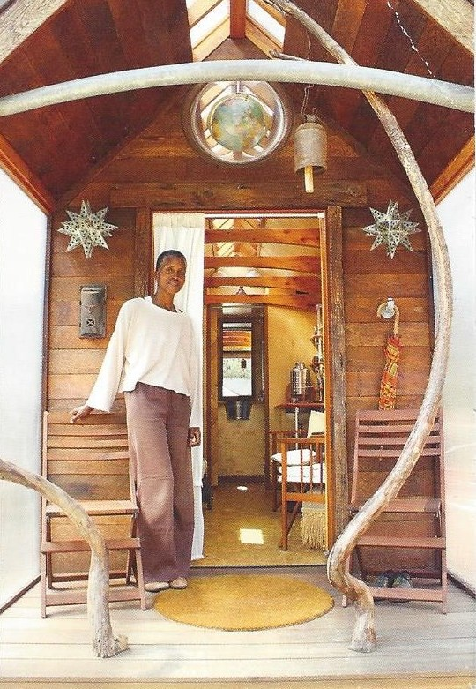
Does the design criteria
reflect the aesthetics of the
community and neighborhood?
Does the design criteria
fit with the unique nature of
tiny homes on wheels?
Does the design criteria
reflect the fact that most
2nd dwelling units cannot be
seen from a public street?
daniel.fitzpatrick@americantinyhouseassociation.org

Slide 26
Alternative Design Criteria Language
If the second unit is visible from the city street it shall
complement the character of the primary residence
or general neighborhood in form, height, number of stories,
materials and color. If the 2nd dwelling unit is not visible from
the city street, the unit may be designed to complement
and aesthetically fit the design character of the neighborhood.
daniel.fitzpatrick@americantinyhouseassociation.org

Slide 27
Amendments-- Continued
Mobile homes and travel trailers shall not be permitted
as second units. Provisions of this subsection shall not
apply to Tiny Homes on Wheels as defined in this ordinance.

Slide 28
THE END
Question
Comments
Discussion

